Slide 1
Empirical Study on Determinants of
Employment Security in Korea
2021.12.04
EUN SEON KIM

Slide 2
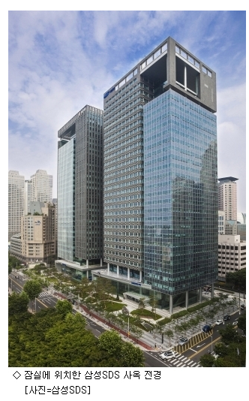
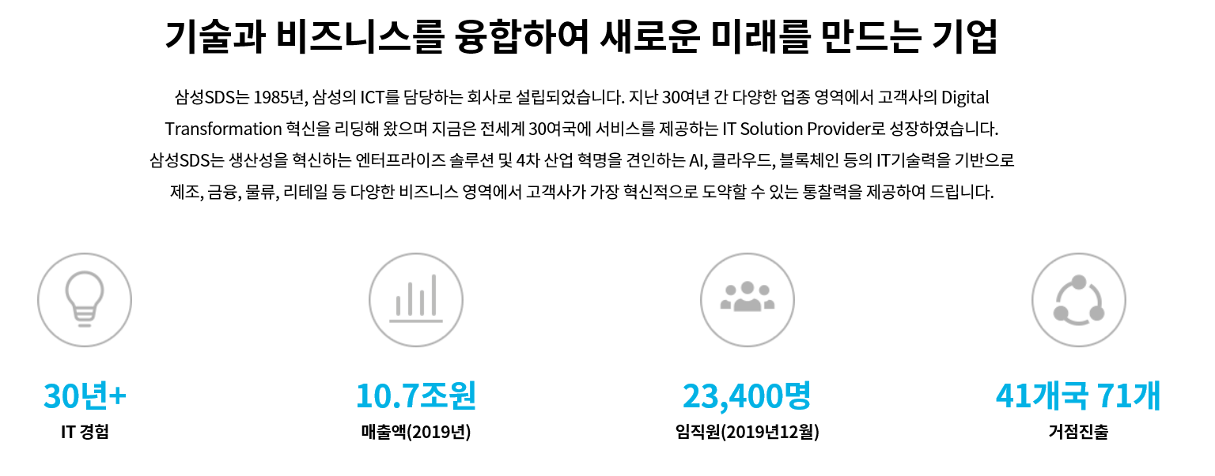
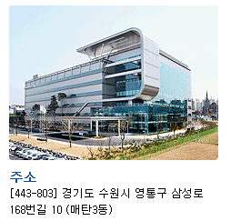
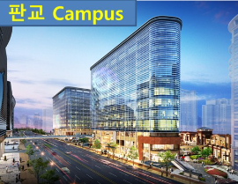
Global Leading IT Company – Samsung SDS
We made new Future through the Integration of Technology & Business( Since 1985 )
상암, 수원, 춘천, 구미 데이터센터
4 Big Data Center
HQ Located at Jamsil
물류 사이트: 판교,안성,이천,창원,천안
5 Logistics Site
2

Slide 3
Table of Contents
1. Interest
2. Definition
3. research model
4. Result
5. Summary
[References]

Slide 4
1. Interest - Personal
Why? “Employment Security ?”
Experienced of HR
4th Industiral revolution
Job is Related to IT
Not only Theory but also reality.

Slide 5
1. Interest – Academical(1/2)
1. Due to the technology, Job is reduced Vs. Job is increased → Same Org. but opposite result
➔ Dose the technology impact on the Employment Security?
Employment Security level is low | Employment Security level is not low
① THE FUTURE OF EMPLOYMENT: HOW SUSCEPTIBLE ARE JOBS TO COMPUTERISATION (Carl Benedikt Frey, Michael A. Osborne, 2013) 702개 직업에 대해 컴퓨터화 가능성을 예측. 현재 미국내 직업 중 47% 직업이 컴퓨터화 가능성 고위험군으로 분류 (10년 또는 20년 안에 컴퓨터로 대체 가능) 운송 및 물류, 사무직 및 관리직, 생산직이 고위험군에 속함. 임금,학력 높고, 창의성과 사회적 지능(Social intelligence)을 요구하는 직업일수록 컴퓨터 대체 가능성 적음. Impact on Employment (-) | ① The Future of Jobs Report 2018(Centre for the New Economy and Society). (WEF Insight Report,2018) 향후 ’22년까지 기술 발전으로 세계에서 창출될 일자리는 1억 3,300만 개에 달할 것으로 추산, 반면 로봇에 의해 대체될 일자리는 그 절반 수준인 7500만 개로 예상. Impact on Employment (+)
② 자동화 기술의 발전이 지역노동시장 중간일자리 감소에 미치는 영향(잠재성장모형의 적용), (김민영, 조민지, 임업, 2017) 자동화 기술의 발전이 국가 전체적인 일자리 구조에 영향을 미칠 뿐만 아니라 지역노동시장 내 일자리 구조에도 차별적인 영향을 미침. Impact on Employment (-) | ②기술혁신이 중장기 인력수요에 미치는 효과(이시균,박진희,정재현,김수현,이혜연, 2018) 4차 산업혁명이 제대로 수행되면 고용이 증가함. 산업별 고용규모도 다소 차이를 보이겠지만 대부분의 산업에서 일자리 증가가 가능할 것으로 진단함. Impact on Employment (+)
Authentic WEF(World Economic Forum), it reported opposite result.
Need to study for Determinants of Labor demand(Hicks-Marshall's Low)
5

Slide 6
1. Interest – Academical(2/2)
2. Employment Security level is low Vs. isn’t low → opposite result
➔ Need to study for Determinants of Emp. Security
Employment Security level is low | Employment Security level is not low
① 고용유지율을 통한 우리나라 고용안정성 수준은 낮고 노동력 집단별로 고용안정성 수준의 격차가 있는 것으로 판단.(이시균.이주현, 2008) ② 3년 직장유지율을 통해 국제비교 결과 미국, 영국, 독일에 비해 직업안정성이 낮다고 평가(정이환, 2014) ③ 이런 현상이 모든 계층에서 발생하기 보다 이중 노동시장 구조에 의한 양극화 현상이라고 평가(금재호, 조준모, 2005) Impact on Employment security(-) | ① 우리나라 고용안정성은 2003년이후 많이 증가했고, 향후 고령화로 인한 직업안정성은 좀 더 증가할 것으로 예상.(경제활동인구조사 사용, 연령 20~54로 제한함) (김기덕,오수봉, 2019) ② 국가간 비교를 통해 모든 국가에서 고용안정성이 약화되고 장기고용 관행이 무너지고 있다는데 부정적인 분석 결과 제시(OECD보고서, 1997),(Auer & Cazes, 2000) Impact on Employment security(+)
3. Factors that increase employment insecurity are globalization and technological innovation
➔ There is no empirical analysis of productivity, consumption, and technological innovation.
6

Slide 7
2. Definition - by ILO(Job Security & Employment Security)
Job security is the possession of a niche in work, allowing some control over the content of a job, what the worker actually does and the opportunity he or she has of building a career. Another way of presenting job security is to refer to property rights in a persons work.
In other words, whereas
employment security refers to the sense of attachment to a current enterprise or establishment,
job security refers to the sense of attachment to a particular job or range of tasks.
Source : https://www.ilo.org/global/standards/subjects-covered-by-international-labour-standards/employment-security/lang--en/index.htm
7

Slide 8
2. Definition – this Study(Job Security & Employment Security)
Job security
job security in a broad meaning
Job security is a sense of preoccupation with a particular job or scope of work.
A concept that provides workers with the ability to stably improve their working conditions throughout their lifetime and to find a new job easily if they lose their job.
Job security is a concept that includes employment security
employment security
job security in narrow meaning
Employment security is a sense of obsession with the current company or facility.
The concept of keeping your current job stable
8

Slide 9
2. Definition – Measure Method (Employment Security)
OECD’s Measure Method
OECD(1997), Is job insecurity on the increase in OECD countries?, OECD Employment outlook.
- employment tenure: Average length of service a worker has worked with the same employer
- retention rates: the proportion of workers with whom an individual is still working with his or her current employer after n years
In this paper, employment security is defined as the employment retention rate.
: Proportion of workers with whom an individual still works with his or her current employer
after n years
(Easy to measure, the concept of employment security is well explained)
9

Slide 10
3. research model(Hicks-Marshall's Law)
employment security
elasticity of labor demand
The price of labor(wage)
production technology
. average monthly wage
prices of other factors of production
. R&D expenditure growth rate
Labor Group
labor productivity
consumer demand
. demographic
(age, gender, education)
. Industry Characteristics
(Job type, company size, employment type, position of employment)
. union
. Total capital investment efficiency
. Consumption (sales growth rate)
10

Slide 11
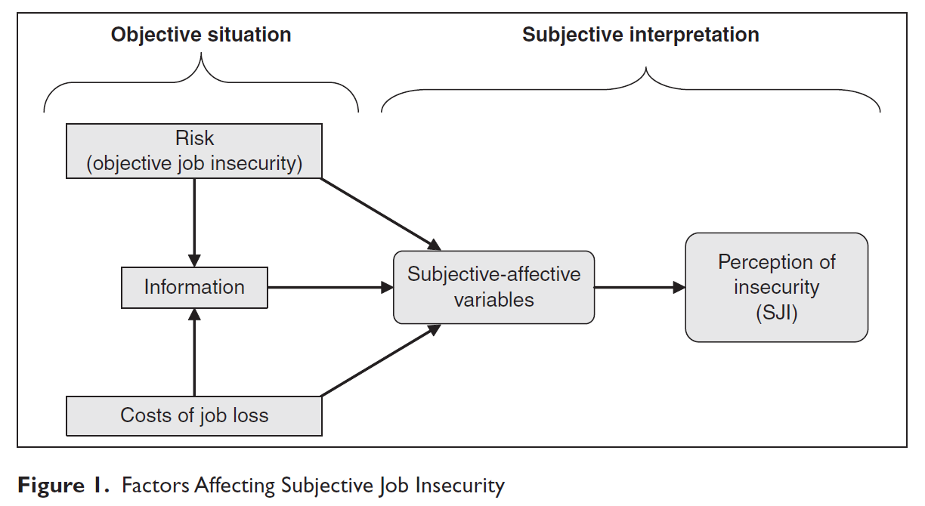
3. research model(Integrated Model, Describing Job insecurity)
Integrated Employment Security Model (Sverke and Hellgren, 2002)
Analyzes the factors that affect job security when ‘subjective experience of employment security’ is influenced by objective information such as demographic characteristics, job characteristics, and industry characteristics variables.
1.Objective job insecurity
1.1 Individual demographics characteristics
- Gender
- Age
- Education
1.2 Individual job related characteristics
- Sector of activity(농업/산업/건설)
- Type of conract(정규직/비정규직)
- Trade union membership(노조가입)
- public sector/civil servant(공공기관/공무원)
- 사업체 규모
2. Costs of job loss
- 금전상의 비용(연봉총액/연봉총액의제곱)
- 다른직업 찾기어려움(장기구직/구직활동안함/고용주바꿈)
- 가족구성(자녀있음/결혼유무)
R² : 알려지지 않은 직업 불안정성(심리적 성질등)
Source: Determinants of job_insecurity in five European Countires.
11

Slide 12
3. research model(Integrated Model, Describing Job insecurity)
Integrated Employment Security Model
Analyzes the factors that affect job security when ‘subjective experience of employment security’ is influenced by objective information such as demographic characteristics, job-related characteristics, and industry characteristics variables.
Demo-graphic
.Age
.Gender
.Education
인구학적특성
Job-related
.Average monthly wage
.Job type,
.company size,
employment type,
position of employment
직무특성
subjective experience of employment security
employment security
psycho-logical
.Wages or income satisfaction
.job security satisfaction
.job satisfaction
.Working Environment Satisfaction
‘Y Variable’
Eco-nomic
.Total capital investment efficiency
.sales growth rate
.R&D expenditure growth rate
12
‘X’s Variables’

Slide 13
3. research model(Logistic Regression Analysis)
Logistic Regression Analysis
Y: Binomial variable indicating whether or not employment security(stable=1, not stable=0)
Simple Logistic Regression
$$\log{\frac{P(y=1ㅣx)}{1−P(y=1 ㅣ x)}= α+βx+ε}$$
Multiple Logistic Regression
$$\log{\frac{P(y=1ㅣㅣ x1,….,xp)}{1−P(y=1 ㅣ x1,….,xp)}= α+β1x1+…. +βpxp}$$
13

Slide 14
3. research model(Data)
Y variable: Employment Security - Converted to employment Security Satus based on 1 , 2 , 5 , and 10 years of job retention
X variables: demographic, industry, psychological characteristics variables, Ecomomic characteristics variables
(2009~2019)
job satisfaction
Economic characteristics
employment information
Korea Labor Panel Survey
- Personal Data
Demographic:
.Age
.Gender
.Education
- Job history Data
Industry
: .Average monthly wage
.Job type,
.company size,
.employment type,
.position of employment
- Job history Data
. employment Security Satus
Korea Labor Panel Survey
- Personal Data
psycho-logical:
.Wages or income satisfaction
.job security satisfaction
.job satisfaction
.Working Environment Satisfaction
Bank of Korea Economic Statistical System
- Business management analysis statistics
Eco-nomic:
.Total capital investment efficiency
.sales growth rate
.R&D expenditure growth rate
14

Slide 15
4. Result - descriptive statistics
Year | 20대이하 | 30대 | 40대 | 50대 | 6-70대
2000 | 390 | 413 | 361 | 184 | 186
2001 | 359 | 352 | 279 | 175 | 168
2002 | 357 | 416 | 283 | 153 | 149
2003 | 371 | 397 | 224 | 162 | 145
2004 | 306 | 378 | 263 | 140 | 138
2005 | 340 | 381 | 265 | 176 | 132
2006 | 282 | 368 | 259 | 177 | 149
2007 | 267 | 349 | 273 | 159 | 128
2008 | 262 | 363 | 268 | 177 | 181
2009 | 246 | 297 | 234 | 171 | 178
2010 | 249 | 370 | 251 | 218 | 186
2011 | 220 | 320 | 256 | 196 | 191
2012 | 229 | 289 | 248 | 169 | 185
2013 | 222 | 274 | 224 | 173 | 184
2014 | 186 | 239 | 176 | 149 | 159
2015 | 196 | 207 | 170 | 151 | 137
2016 | 237 | 160 | 155 | 111 | 138
2017 | 180 | 114 | 120 | 95 | 109
2018 | 131 | 80 | 89 | 52 | 96
2019 | 6 | 7 | 4 | 4 | 4
Year | 20대이하 | 30대 | 40대 | 50대 | 6-70대
2000 | 25.42% | 26.92% | 23.53% | 11.99% | 12.13%
2001 | 26.93% | 26.41% | 20.93% | 13.13% | 12.60%
2002 | 26.29% | 30.63% | 20.84% | 11.27% | 10.97%
2003 | 28.56% | 30.56% | 17.24% | 12.47% | 11.16%
2004 | 24.98% | 30.86% | 21.47% | 11.43% | 11.27%
2005 | 26.28% | 29.44% | 20.48% | 13.60% | 10.20%
2006 | 22.83% | 29.80% | 20.97% | 14.33% | 12.06%
2007 | 22.70% | 29.68% | 23.21% | 13.52% | 10.88%
2008 | 20.94% | 29.02% | 21.42% | 14.15% | 14.47%
2009 | 21.85% | 26.38% | 20.78% | 15.19% | 15.81%
2010 | 19.54% | 29.04% | 19.70% | 17.11% | 14.60%
2011 | 18.60% | 27.05% | 21.64% | 16.57% | 16.15%
2012 | 20.45% | 25.80% | 22.14% | 15.09% | 16.52%
2013 | 20.61% | 25.44% | 20.80% | 16.06% | 17.08%
2014 | 20.46% | 26.29% | 19.36% | 16.39% | 17.49%
2015 | 22.76% | 24.04% | 19.74% | 17.54% | 15.91%
2016 | 29.59% | 19.98% | 19.35% | 13.86% | 17.23%
2017 | 29.13% | 18.45% | 19.42% | 15.37% | 17.64%
2018 | 29.24% | 17.86% | 19.87% | 11.61% | 21.43%
* Analysis of the number of retirees by year among those who joined the company after 2000(21,315 record)
Retirement rate among young people in their 30s and younger is higher every year (The number of those under the age of 29 has increased recently.)
In the case of people in their 40s, the proportion of retirement is always higher than that in their 50s.
In the case of people in their 50s, the proportion of retirements continues to increase, but has recently decreased.
Due to the aging population, the proportion of retirees is gradually increasing due to active economic activities in the age group in their 60s and 70s.
15

Slide 16
4. Result - descriptive statistics
년도 | 고졸이하 | 전문대 | 대학 | 대학원이상
2000 | 966 | 241 | 305 | 39
2001 | 839 | 227 | 251 | 28
2002 | 785 | 250 | 291 | 44
2003 | 734 | 245 | 282 | 43
2004 | 714 | 200 | 267 | 49
2005 | 706 | 251 | 299 | 47
2006 | 670 | 250 | 279 | 41
2007 | 649 | 228 | 261 | 45
2008 | 668 | 265 | 286 | 40
2009 | 603 | 225 | 257 | 48
2010 | 698 | 263 | 286 | 40
2011 | 658 | 246 | 267 | 23
2012 | 597 | 234 | 252 | 45
2013 | 599 | 225 | 230 | 36
2014 | 489 | 204 | 204 | 22
2015 | 458 | 196 | 187 | 31
2016 | 418 | 185 | 184 | 22
2017 | 299 | 164 | 145 | 12
2018 | 249 | 107 | 88 | 9
년도 | 고졸이하 | 전문대 | 대학 | 대학원이상
2000 | 62.28% | 15.54% | 19.66% | 2.51%
2001 | 62.38% | 16.88% | 18.66% | 2.08%
2002 | 57.30% | 18.25% | 21.24% | 3.21%
2003 | 56.29% | 18.79% | 21.63% | 3.30%
2004 | 58.05% | 16.26% | 21.71% | 3.98%
2005 | 54.18% | 19.26% | 22.95% | 3.61%
2006 | 54.03% | 20.16% | 22.50% | 3.31%
2007 | 54.86% | 19.27% | 22.06% | 3.80%
2008 | 53.06% | 21.05% | 22.72% | 3.18%
2009 | 53.22% | 19.86% | 22.68% | 4.24%
2010 | 54.23% | 20.44% | 22.22% | 3.11%
2011 | 55.11% | 20.60% | 22.36% | 1.93%
2012 | 52.93% | 20.74% | 22.34% | 3.99%
2013 | 54.95% | 20.64% | 21.10% | 3.30%
2014 | 53.21% | 22.20% | 22.20% | 2.39%
2015 | 52.52% | 22.48% | 21.44% | 3.56%
2016 | 51.67% | 22.87% | 22.74% | 2.72%
2017 | 48.23% | 26.45% | 23.39% | 1.94%
2018 | 54.97% | 23.62% | 19.43% | 1.99%
High shool and below college university Graduate school or higher
* Analysis of the number of retirees by year among those who joined the company after 2000(21,315 record)
The proportion of retirees with a high school diploma or less is very high, but it has been gradually decreasing in recent years
The proportion of college and university retirements continues to increase
(* This reflects the social phenomenon of increasing educational attainment.)
16

Slide 17
4. Result - descriptive statistics
년도 | 퇴직자수 |  | 퇴직자비율
 | 남성 | 여성 | 남성 | 여성
2000 | 730 | 821 | 47.07% | 52.93%
2001 | 684 | 661 | 50.86% | 49.14%
2002 | 683 | 687 | 49.85% | 50.15%
2003 | 637 | 667 | 48.85% | 51.15%
2004 | 591 | 639 | 48.05% | 51.95%
2005 | 646 | 657 | 49.58% | 50.42%
2006 | 603 | 637 | 48.63% | 51.37%
2007 | 572 | 611 | 48.35% | 51.65%
2008 | 582 | 677 | 46.23% | 53.77%
2009 | 521 | 612 | 45.98% | 54.02%
2010 | 600 | 687 | 46.62% | 53.38%
2011 | 540 | 654 | 45.23% | 54.77%
2012 | 516 | 612 | 45.74% | 54.26%
2013 | 513 | 577 | 47.06% | 52.94%
2014 | 396 | 523 | 43.09% | 56.91%
2015 | 384 | 488 | 44.04% | 55.96%
2016 | 354 | 455 | 43.76% | 56.24%
2017 | 270 | 350 | 43.55% | 56.45%
2018 | 193 | 260 | 42.60% | 57.40%
Man Woman
* Analysis of the number of retirees by year among those who joined the company after 2000(21,315 record)
In the case of women, the proportion of retirement is higher than that of men every year except in 2001, and the proportion continues to increase as the year increases.
17

Slide 18
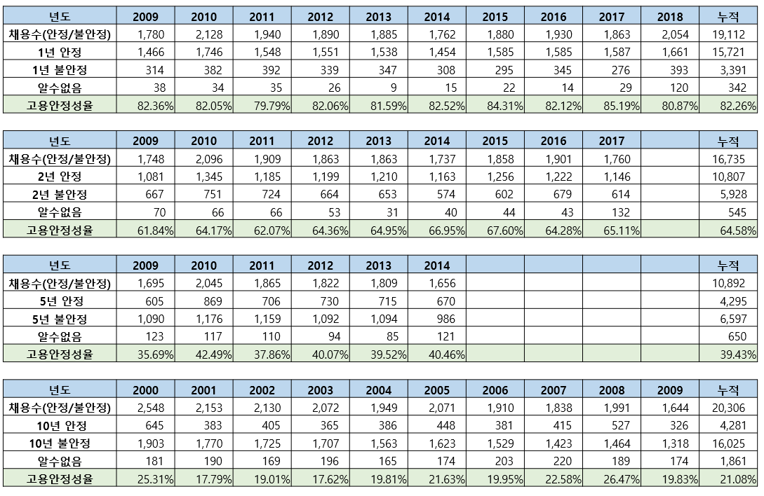
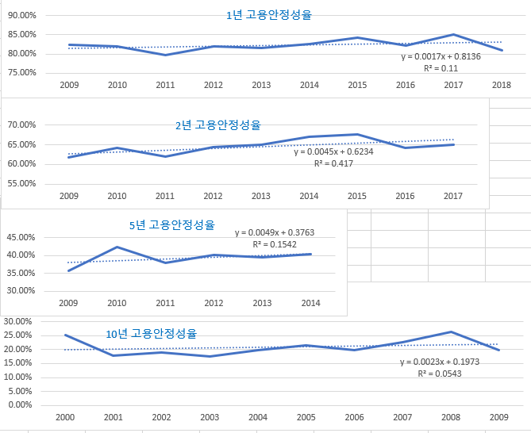
4. Result - descriptive statistics
Although there are fluctuations by year, we can confirm the trend line of the overall increase in employment security
1 year employment security rate
2 year employment security rate
5 year employment security rate
10 year employment security rate
18

Slide 19
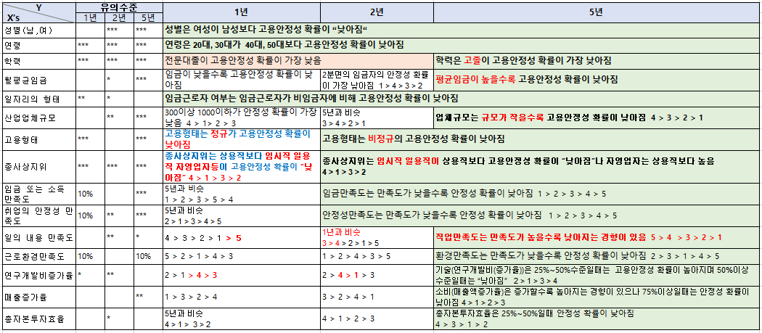
4. Result - Multiple Logistic Regression
Most variables are significant but~.
* Significant : *** (0.1%), **(1%), *(5%), .(10%)
19

Slide 20
4. Result - Multiple Logistic Regression
Variable selection method - ‘backward’ elimination : remove invalid variables
Employment type (regular workers, non-regular workers) and working environment satisfaction (very satisfied to very dissatisfied) were removed from the determinants employment Security .
> step_sflag <- step(aa2, direction = "backward")
Start: AIC=50101.94
stable ~ yearflag + age + gender + aca + mpay + imgumyn + empscale +
regular + sangyoung + wagesvey + stabsvey + worksvey + envsvey +
rndrate + earnrate + equityrate
Df Deviance AIC
- envsvey 5 49991 50095
- regular 1 49989 50101
<none> 49988 50102
- imgumyn 1 50001 50113
- rndrate 3 50008 50116
- worksvey 5 50016 50120
- mpay 4 50016 50122
- equityrate 3 50018 50126
- earnrate 3 50026 50134
- empscale 4 50032 50138
- stabsvey 5 50052 50156
- gender 1 50048 50160
- wagesvey 5 50060 50164
- aca 3 50111 50219
- age 4 50439 50545
- sangyoung 4 51022 51128
- yearflag 3 57565 57673
Step: AIC=50093.95
stable ~ yearflag + age + gender + aca + mpay + imgumyn + empscale +
sangyoung + wagesvey + stabsvey + worksvey + rndrate + earnrate +
equityrate
Df Deviance AIC
<none> 49992 50094
- rndrate 3 50011 50107
- imgumyn 2 50014 50112
- worksvey 5 50021 50113
- mpay 4 50020 50114
- equityrate 3 50022 50118
- earnrate 3 50030 50126
- empscale 4 50036 50130
- gender 1 50051 50151
- wagesvey 5 50066 50158
- stabsvey 5 50066 50158
- aca 3 50119 50215
- age 4 50441 50535
- sangyoung 4 51340 51434
- yearflag 3 57572 57668
20

Slide 21
4. Result – ANOVA analysis
Group Difference Analysis
Work period hire year record
10yr 2000~2009 5,339
5yr 2005~2014 9,963
2yr 2008~2017 10,720
1yr 2009~2018 9,937
Stable period hire year record
10Yr 2000~2009 8,561
5yr 2005~2014 15,351
2yr 2008~2017 18,245
1yr 2009~2018 18,493
ANOVA analysis
Pr(>F) is p-value.
If this value is less than 0.05, there is a statistically significant difference and there is a group difference.
21

Slide 22
4. Result – ANOVA analysis(R&D expenditure growth rate)
2009~2019 11years Average rank (low is 1 quarter, high 4 quarter) | 25~50% | 50~75% | 75%~
1 quarter ( ~25%) | 2 quarter (25~50%) | 3 quarter (50~75%) | 4 quarter (75%~ )
C11 drink. C19 Coke, briquettes and petroleum products. G Wholesale and Retail. H Transportation and Warehouse. I Accommodation and restaurant business. L real estate business. N Business Facility Management and Business Support and Rental Service Business R Art, Sports, and Leisure-related Services. S95 Repairing Personal and Consumer Goods. | C10 groceries. C14 Clothing, clothing accessories, and fur products. C16 Wood and wood products (excluding furniture) C17 Pulp, Paper and Paper Products E Sewage and waste disposal, raw material regeneration, & environmental restoration business. F construction industry. P education service. S96 and other personal service industries. | C13 textile products (excluding clothing) C15 leather, bag and shoes. C18 Printing and Recording Media Reproduction Up C23 Non-metallic Mineral Products. C24 primary metal. C25 Metal Processing Products (excluding machinery and furniture) C31 and other transportation equipment. C32 households. D35 Electricity, Gas, Steam and Air Conditioning Supplies | C20 Chemicals and Chemicals (excluding drugs) C21 Medical Substances and Medicines C22 Rubber products and plastic products. C26 Electronic components, computers, video, sound and communication equipment. C27 Medical, Precision, Optical and Clock C28 electrical equipment. C29 Other machines and equipment. C30 cars and trailers. C33 Manufacturing other products. J Information and Communication Business. M professional, science and technology services.
Group Difference Analysis by quarter |  | 25~50% | 50~75% | 75%~
 | 1 year | 2 year | 5 year | 10 year
안 정 성 | Df Sum Sq Mean Sq F value Pr(>F) rnd 3 19 6.173 4.301 0.00486 ** Residuals 18489 26537 1.435 --- Signif. codes: 0 ‘***’ 0.001 ‘**’ 0.01 ‘*’ 0.05 ‘.’ 0.1 ‘ ’ 1 | Df Sum Sq Mean Sq F value Pr(>F) rnd 3 28 9.494 4.17 0.00583 ** Residuals 18241 41530 2.277 --- Signif. codes: 0 ‘***’ 0.001 ‘**’ 0.01 ‘*’ 0.05 ‘.’ 0.1 ‘ ’ 1 | Df Sum Sq Mean Sq F value Pr(>F) rnd 3 33 10.89 3 0.0293 * Residuals 15347 55703 3.63 --- Signif. codes: 0 ‘***’ 0.001 ‘**’ 0.01 ‘*’ 0.05 ‘.’ 0.1 ‘ ’ 1 | summary(ww10out31) Df Sum Sq Mean Sq F value Pr(>F) rnd 3 7 2.205 0.634 0.593 Residuals 8557 29764 3.478
 | Difference : YES | Difference : YES | Difference : YES | Difference : No
근 무 개 월 수 | Df Sum Sq Mean Sq F value Pr(>F) rnd 3 3693 1230.9 2.481 0.0591 . Residuals 9933 4928482 496.2 --- Signif. codes: 0 ‘***’ 0.001 ‘**’ 0.01 ‘*’ 0.05 ‘.’ 0.1 ‘ ’ 1 | Df Sum Sq Mean Sq F value Pr(>F) rnd 3 5873 1957.6 3.353 0.0181 * Residuals 10716 6257294 583.9 --- Signif. codes: 0 ‘***’ 0.001 ‘**’ 0.01 ‘*’ 0.05 ‘.’ 0.1 ‘ ’ 1 | Df Sum Sq Mean Sq F value Pr(>F) rnd 3 6168 2056 2.024 0.108 Residuals 9959 10117235 1016 | Df Sum Sq Mean Sq F value Pr(>F) rnd 3 8383 2794 1.045 0.371 Residuals 5335 14269455 2675
 | Difference : YES | Difference : YES | Difference : No | Difference : No
22

Slide 23
4. Result – ANOVA analysis(Sales growth rate)
2009~2019 11years Average rank (low is 1 quarter, high 4 quarter) | 25~50% | 50~75% | 75%~
1 quarter ( ~25%) | 2 quarter (25~50%) | 3 quarter (50~75%) | 4 quarter (75%~ )
C13 textile products (excluding clothing) C14 Clothing, clothing accessories, and fur products. C17 Pulp, Paper and Paper Products. C23 Non-metallic Mineral Products. C24 primary metal. C28 electrical equipment. C31 and other transportation equipment. F construction industry. | C11 drink. C16 Wood and wood products (excluding furniture) C20 Chemicals and Chemicals (excluding drugs) C25 Metal Processing Products (excluding machinery and furniture) C26 Electronic components, computers, video, sound and communication equipment. C33 Manufacturing other products. D35 Electricity, Gas, Steam and Air Conditioning Supplies H Transportation and Warehouse. J Information and Communication Business. R Art, Sports, and Leisure-related Services. | C10 groceries. C15 leather, bag and shoes. C18 Printing and Recording Media Reproduction Up C19 Coke, briquettes and petroleum products. C22 Rubber products and plastic products. C29 Other machines and equipment. C30 cars and trailers. C32 households. E Sewage and waste disposal, raw material regeneration, and environmental restoration business. G Wholesale and Retail. | C21 Medical Substances and Medicines C27 Medical, Precision, Optical and Clock I Accommodation and restaurant business. M professional, science and technology services. L real estate business. N Business Facility Management and Business Support and Rental Service Business P education service. S95 Repairing Personal and Consumer Goods. S96 and other personal service industries.
Group Difference Analysis by quarter |  | 25~50% | 50~75% | 75%~
 | 1 year | 2 year | 5 year | 10 year
안 정 성 | Df Sum Sq Mean Sq F value Pr(>F) earn 3 7 2.292 1.596 0.188 Residuals 18489 26549 1.436 | Df Sum Sq Mean Sq F value Pr(>F) earn 3 4 1.358 0.596 0.617 Residuals 18241 41555 2.278 | Df Sum Sq Mean Sq F value Pr(>F) earn 3 4 1.496 0.412 0.744 Residuals 15347 55731 3.631 | Df Sum Sq Mean Sq F value Pr(>F) earn 3 4 1.370 0.394 0.757 Residuals 8557 29766 3.479
 | Difference : No | Difference : No | Difference : No | Difference : No
근 무 개 월 수 | Df Sum Sq Mean Sq F value Pr(>F) earn 3 5207 1736 3.499 0.0148 * Residuals 9933 4926968 496 --- Signif. codes: 0 ‘***’ 0.001 ‘**’ 0.01 ‘*’ 0.05 ‘.’ 0.1 ‘ ’ 1 | Df Sum Sq Mean Sq F value Pr(>F) earn 3 5383 1794 3.073 0.0266 * Residuals 10716 6257784 584 --- Signif. codes: 0 ‘***’ 0.001 ‘**’ 0.01 ‘*’ 0.05 ‘.’ 0.1 ‘ ’ 1 | Df Sum Sq Mean Sq F value Pr(>F) earn 3 25504 8501 8.384 1.46e-05 *** Residuals 9959 10097899 1014 --- Signif. codes: 0 ‘***’ 0.001 ‘**’ 0.01 ‘*’ 0.05 ‘.’ 0.1 ‘ ’ 1 | Df Sum Sq Mean Sq F value Pr(>F) earn 3 115944 38648 14.56 1.92e-09 *** Residuals 5335 14161894 2655 --- Signif. codes: 0 ‘***’ 0.001 ‘**’ 0.01 ‘*’ 0.05 ‘.’ 0.1 ‘ ’ 1
 | Difference : YES | Difference : YES | Difference : YES | Difference : YES
23

Slide 24
4. Result – ANOVA analysis(Total capital investment efficiency)
2009~2019 11years Average rank (low is 1 quarter, high 4 quarter) | 25~50% | 50~75% | 75%~
1 quarter ( ~25%) | 2 quarter (25~50%) | 3 quarter (50~75%) | 4 quarter (75%~ )
C19 Coke, briquettes and petroleum products. C24 primary metal. C31 and other transportation equipment. D35 Electricity, Gas, Steam and Air Conditioning Supplies H Transportation and Warehouse. L real estate business. R Art, Sports, and Leisure-related Services. S96 and other personal service industries. | C11 drink. C14 Clothing, clothing accessories, and fur products. C16 Wood and wood products (excluding furniture) C17 Pulp, Paper and Paper Products. C20 Chemicals and Chemicals (excluding drugs) C23 Non-metallic Mineral Products. C28 electrical equipment. G Wholesale and Retail. I Accommodation and restaurant business. | C10 groceries. C13 textile products (excluding clothing) C15 leather, bag and shoes. C21 Medical Substances and Medicines C22 Rubber products and plastic products. C26 Electronic components, computers, video, sound and communication equipment. C29 Other machines and equipment. C30 cars and trailers. E Sewage and waste disposal, raw material regeneration, and environmental restoration business. F construction industry. | C18 Printing and Recording Media Reproduction Up C25 Metal Processing Products (excluding machinery and furniture) C27 Medical, Precision, Optical and Clock C32 households. C33 Manufacturing other products. J Information and Communication Business. M professional, science and technology services. N Business Facility Management and Business Support and Rental Service Business P education service. S95 Repairing Personal and Consumer Goods.
Group Difference Analysis by quarter |  | 25~50% | 50~75% | 75%~
 | 1 year | 2 year | 5 year | 10 year
안 정 성 | Df Sum Sq Mean Sq F value Pr(>F) equity 3 25 8.306 5.788 0.000597 *** Residuals 18489 26531 1.435 --- Signif. codes: 0 ‘***’ 0.001 ‘**’ 0.01 ‘*’ 0.05 ‘.’ 0.1 ‘ ’ 1 | Df Sum Sq Mean Sq F value Pr(>F) equity 3 20 6.736 2.958 0.031 * Residuals 18241 41539 2.277 --- Signif. codes: 0 ‘***’ 0.001 ‘**’ 0.01 ‘*’ 0.05 ‘.’ 0.1 ‘ ’ 1 | Df Sum Sq Mean Sq F value Pr(>F) equity 3 30 9.873 2.72 0.0429 * Residuals 15347 55706 3.630 --- Signif. codes: 0 ‘***’ 0.001 ‘**’ 0.01 ‘*’ 0.05 ‘.’ 0.1 ‘ ’ 1 | Df Sum Sq Mean Sq F value Pr(>F) equity 3 14 4.793 1.378 0.247 Residuals 8557 29756 3.477
 | Difference : YES | Difference : YES | Difference : YES | Difference : No
근 무 개 월 수 | Df Sum Sq Mean Sq F value Pr(>F) equity 3 8121 2707.1 5.461 0.000952 *** Residuals 9933 4924053 495.7 --- Signif. codes: 0 ‘***’ 0.001 ‘**’ 0.01 ‘*’ 0.05 ‘.’ 0.1 ‘ ’ 1 | Df Sum Sq Mean Sq F value Pr(>F) equity 3 11894 3965 6.796 0.000142 *** Residuals 10716 6251273 583 --- Signif. codes: 0 ‘***’ 0.001 ‘**’ 0.01 ‘*’ 0.05 ‘.’ 0.1 ‘ ’ 1 | Df Sum Sq Mean Sq F value Pr(>F) equity 3 17309 5770 5.686 0.000692 *** Residuals 9959 10106095 1015 --- Signif. codes: 0 ‘***’ 0.001 ‘**’ 0.01 ‘*’ 0.05 ‘.’ 0.1 ‘ ’ 1 | Df Sum Sq Mean Sq F value Pr(>F) equity 3 52848 17616 6.607 0.000188 *** Residuals 5335 14224989 2666 --- Signif. codes: 0 ‘***’ 0.001 ‘**’ 0.01 ‘*’ 0.05 ‘.’ 0.1 ‘ ’ 1
 | Difference : YES | Difference : YES | Difference : YES | Difference : YES
24

Slide 25
5. Summary
Analysis of factors influencing employment security by applying Hicks Marshall's Law Frame.
Various cause variables affect employment security, especially sales growth rate, total capital investment efficiency, Production technology has a different influence on employment security depending on the position of the quadrant
employment security
. average monthly wage
. R&D expenditure growth rate
The price of labor(wage)
production technology
. The higher the monthly average wage, the lower the probability of employment security
prices of other factors of production
. Total capital investment efficiency
Labor Group
. Consumption (sales growth rate)
labor productivity
. when it is 25% to 50% is Higher If it's more than 50%, Lower
2 > 1 > 3 > 4
. demographic
(age, gender, education)
. Industry Characteristics
(Job type, company size, employment type, position of employment)
. union
consumer demand
. When it is increased, the employment security decreases,
but increases when it is 75% or more.
4 > 1 > 2> 3
. Gender: Women's employment security is lower than men. . Age: 20s is lower than 30s. . Education: high school/college graduate is the lowest. . irregular job is lower than other job. .The smaller the size of the company, the lower the probability. .Temporary and daily workers is the lowest.
.when it increases, that tends to increase, but when it's more than 75%, the probability of employment security decreases.
2 > 3 > 1 > 4
25

Slide 26
[References]
Aikaeli, J. and B. K. Mkenda(2014), Determinants of Informal Employment: a Case of Tanzania Construction Industry, Botswana Journal of Economics, Vol. 12, No. 2, 2014, pp. 51-73.
Basheier, A. A. and A. N. Wahban(2013), The Determinants of Employment in Jordan: a Time Series Anaylsis, International Review of Management and Business Research, Vol. 2, No. 4, 2013, pp. 927-936.
Carl Benedikt Frey, Michael A. Osborne(2013), "THE FUTURE OF EMPLOYMENT: HOW SUSCEPTIBLE ARE JOBS TO COMPUTERISATION".
Global Challenge Insight Report(2016), "The Future of Jobs(Employment, Skills and Workforce Strategy for the Fourth Industrial evolution).
Ibrahim, M. A.(2013), The Determinants of Private Sector Demand for Employment in Egypt: 1990-2007, Advanced in Management & Applied Economics, Vol. 3, No. 1, 2013, pp. 163-182.
Insight Report(2018), The Future of Jobs Report 2018(Centre for the New Economy and Society).
Paul S. Davis '92 (1993), Factors Influencing Employment in the U.S. Automobile Industry.

Slide 27
[References]
금재호ᆞ조준모(2001), 외환위기 전후의 노동시장 불안정성에 대한 연구(한국노동패널 특집), 노동경제전집, 제24권(1), 2001.3, pp.35-66
김기덕(2019), 한국의 고용안정성 변화에 관한 연구, 박사학위논문
김기덕ᆞ어수봉(2019), 한국의 직업안정성 변화와 원인 분석, 직업과 자격 연구, 제8권 제3호, pp. 45-67.
김민영, 조민지, 임업(2017), 자동화 기술의 발전이 지역노동시장 중간일자리 감소에 미치는 영향(잠재성장모형의 적용), 국토연구,2017.6, pp. 25-41.
변양규(2010), 주성분분석을 통한 노동시장 유연성 및 안정성 국제비교, 노동정책연구,2010,제10권 제4호, pp.1-37
손동희․한웅용․전용일(2015), 연구개발투자의 경제성장과 고용효과에 관한 실증연구 –OECD 국가를 중심으로, 국제지역연구, 제19권 제3호, 2015, pp. 177-194.
신범철, 송치웅, 최국현(2012), 기업의 기술혁신 유형에 따른 고용효과 비교분석
이병희 (2000), 반복실업과 실업의 장기화, 한국노동경제학회 勞動經濟論集, Vol.23 No.1 ,2000

Slide 28
[References]
이시균(2017), 고용유지율 결정요인 분석, 산업노동연구 , 23권 2호, 2017; pp.169-193
이시균,박진희,정재현,김수현,이혜연(2018), 기술혁신이 중장기 인력수요에 미치는 효과, 한국고용정보원, 기본연구 2018-2019.
정이환(2014), 국제비교를 통해서 본 한국의 고용불안정, 경제와사회, 2014.09, 103-128(26 pages)
정이환ᆞ전병유(2004), 동아시아 고용체제의 특성과 변화: 한국, 일본, 대만의 고용안정성, 임금구조, 노동시장 분절성의 비교, 산업노동연구, 제10권 제2호 2004; pp.215-252

Slide 29
Thank You.

