Slide 1
Is Risk-Taking in our Nature?: Genetics and Personality in Financial Decisions
Vickie Bajtelsmit Lisa Posey Sharon Tennyson
Colorado State University Pennsylvania State University Cornell University

Slide 2

Nature and Nurture
Individual differences in economic and financial decision making can be attributed to differences in preferences as well as differences in income, wealth, market conditions, and other external factors
Personality traits may play an important role in determining individual preferences as well as affecting responses to external factors.
Genetic propensities for certain personality traits and behaviors can be used to capture innate aspects of preferences that affect financial decision making (nature).
Measurements of how the corresponding traits have manifested in individuals can be used to capture the additional impact of lived experience on preferences that affect financial decision making (nurture).

Slide 3
Data
Health and Retirement Study Panel Data:
  Respondents ages 50-75 who are of European descent and have
    1) Household wealth of at least $10,000 and no greater than $10,000,000,
    2) Hypothetical income gamble questions,
    3) Personality trait questions, and
    4) Genetic data.
Data from Jordà, Knoll, Kuvshinov, Schularick, and Taylor, 2019, QJE.
  Used to calculate the standard deviation of risky asset returns in the market during subjects’ early adulthood (ages 18-30).
Dependent variables:
  Binary variables for holding stocks, owning a business, holding risky assets, having credit card debt, having a mortgage, and having life insurance (each analyzed using logistic regression), and
  Continuous variables for the proportion of nonhousing wealth in stocks, in business assets, and in risky assets, as well as the ratio of credit card debt to income and the loan-to-value ratio of those having mortgages (each analyzed using tobit regression due to truncation at zero).

Slide 4
Areas of Research we Contribute to or Incorporate
Can risk tolerance measures be used to explain risk-taking behavior?
Cohort effects in panel data.
The effect of the Big Five personality traits on economic decision making.
The role of genetics in economic decision making.

Slide 5
Can risk tolerance measures be used to explain risk-taking behavior?
Methods of measurement:
Self-assessed risk tolerance, ex. Are you a risk-taker? or On a scale of 1-10 how much of a risk-taker are you?
Series of “income gamble” questions developed by Barksy, Juster, Kimball, and Shapiro (1997) which are used to create risk tolerance categories of 1-4.
    Anderson & Mellor (2009) document subjects do not always give same responses over multiple waves of HRS.
    Kimball, Sahm, and Shapiro (2009) produce a maximum likelihood estimate of a risk tolerance parameter using answers from multiple waves.
    Linnér, et al. (2019) regress age, gender and interaction terms on the income gamble risk tolerance category for each wave of the survey separately and then average the residuals from these regressions for each subject.
We extend the Linnér, et al. (2019) approach, estimating hypothetical risk tolerance using the average of the residuals after controlling for age, gender, genetics, and personality traits.

Slide 6
HRS Income Gamble Question
Suppose that you are the only income earner in the family. Your doctor recommends that you move because of allergies, and you have to choose between two possible jobs. The first would guarantee your current total family income for life. The second is possibly better paying, but the income is also less certain. There is a 50-50 chance the second job would double your total lifetime income and a 50-50 chance that it would cut it by a third. Which job would you take—the first job or the second job?

Slide 7
Cohort effects in panel data
As pointed out by Fagereng, Gottlieb and Guiso, Jo. of Fin, 2017, it is not possible to distinguish between time, age, and cohort effects in panel data with standard coding of these variables due to an identification problem: “calendar year”=“age”+ “birth year”.
They use stock market returns during the head of household’s formative years (age 18-25), as a proxy for cohort, as do Giuliano and Spilimbergo (2014).
We modify that approach to use the standard deviation of risky asset returns in the market during subjects’ early adulthood (ages 18-30) as a proxy for cohort.
We hypothesize that standard deviation captures the riskiness of the assets, which would have an impact on future willingness to invest.
Therefore, the three variables we use for time, age, cohort are 1) Wave, 2) Age, and 3) StdDev of risky asset returns in the market during ages 18-30.

Slide 8
The effect of Big Five personality traits on economic decision making.
Psychologists have developed a set of personality traits, commonly termed the “Big Five,” whose measures have been found to be relatively stable in individuals after age 50 (Borghans et al., 2008; Cobb-Clark and Schurer, 2012) and predictive of a wide array of behaviors (John and Srivastava, 1999):
  Neuroticism, Extroversion, Agreeableness, Openness, Conscientiousness.
Economic decision making found to be correlated with at least one of the Big Five:
  Business ownership/entrepreneurship (Shane et al., 2010; Leutner et al., 2014; Audretsch et al., 2017; Obschonka et al., 2020).
  Savings behavior (Hershey and Mowen, 2000; ; Nyhus and Webley, 2001; Mayfield, Perdue, and Wooten, 2008; Asebedo et al., 2019).
  Net worth and asset holdings (Brown and Taylor, 2014; Letkiewicz and Fox, 2014; Nabeshima and Seay, 2015).
  Stock market participation (Conlin et al., 2015; Bucciol and Zarri, 2017).

Slide 9
Big 5 Personality Traits
Conscientiousness: reliable, hard-working, and organized
Openness: curious, creative and variety-seeking
Extroversion: affectionate, a joiner, and talkative
Neuroticism: frequently worried or nervous, careful and attentive to detail
Agreeableness: trusting, good-natured and acquiescent

Slide 10
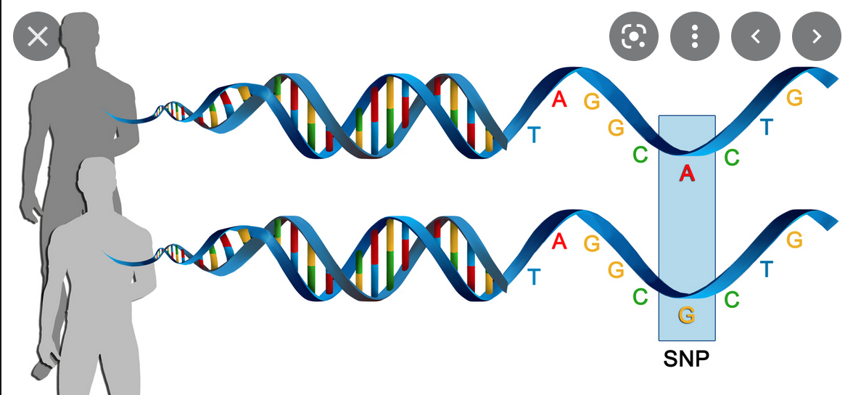
The role of genetics in economic decision making
For complex physical and behavioral traits, the standard is GWAS: Genome-wide Association Studies.
DNA is like a book full of letters (nucleotides A, T, C, G).
The genome has ~ 3 billion nucleotides and most are identical between individuals.
A SNP is a single nucleotide polymorphism – a spot in the genome where some people have a nucleotide that is different than the “major” one that most others have there. Millions of SNPs have been cataloged.
SNPs are what 23andMe and Ancestry.com test for, as do research groups doing Genome-wide Association Studies (GWAS).
Since we have 2 copies of each chromosome, 1 from each parent, GWAS researchers record for each SNP site how many “major” nucleotides subjects have there, 0, 1 or 2.
https://www.genengnews.com/topics/omics/study-finds-genetic-basis-of-common-diseases-may-span-tens-of-thousands-of-snps/

Slide 11
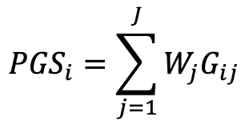
The role of genetics in economic decision making
where i is individual, j is SNP j, Wj is the GWAS coefficient on SNP j and Gij is the number of major nucleotides (0, 1 , or 2) individual i has for SNP j.
The genetic matrix of a typical GWAS will have hundreds of thousands to over a million subjects and millions of SNPs.
Regression analysis is used to find the correlation of each SNP with the trait of interest in the GWAS.
GWAS results include the coefficients for all of the SNPs analyzed and these are often publicly available or made available upon request.
Since complex traits are impacted by small effects from many genes, the coefficient results of a GWAS for a particular trait are used to create a corresponding polygenic score (PGS) for that trait.
Other researchers use the coefficients from the GWAS to create a PGS for the given trait for their subjects (who were not included in the GWAS sample) using their subjects’ own SNP data.
SNP1 SNP2 SNP3 SNP4 SNP5 SNP6 SNP7 …
Subject 1 0 1 1 2 2 1 2 … Subject 2 1 2 2 2 1 2 1 …
Subject 3 0 2 0 2 2 2 2 …
Subject 4 2 1 2 2 0 1 0 …
Subject 5 2 1 1 2 2 2 2 …
Subject 6 1 2 1 2 2 1 2 …
Subject 7 2 2 2 1 1 2 1 …
Subject 8 2 1 1 2 2 2 1 …
Subject 9 1 2 0 2 0 1 2 …
... … … … … … … … …
where i is individual, j is SNP j, Wj is the GWAS coefficient on SNP j and Gij is the number of major nucleotides (0, 1 , or 2) individual i has for SNP j.

Slide 12
The role of genetics in economic decision making
Complex traits are impacted by small effects from many genes.
The results of Genome-Wide-Association-Studies for a particular trait are used to create a corresponding polygenic score (PGS) for that trait.
Researchers use the coefficients from the GWAS to create a PGS for the given trait for their subjects (who were not included in the GWAS sample) using their subjects’ own genetic data.
As shown by Martin et al., 2017 and Ware et al., 2017, predictive analysis using GWAS is only valid within a given ancestry group (European ancestry, African ancestry, Chinese ancestry, etc.).
The Health and Retirement Study has SNP data for ~15,000 of its subjects. We use the European ancestry group (n=12,090) for our analysis.

Slide 13
Genetic Predispositions (PGS Scores)
PGS-Neuroticism
PGS-Extroversion
PGS-Openness
PGS-Educational Attainment
PGS-Risk Tolerance

Slide 14
Empirical Methodology
Estimate various regressions of the form:
Financial Outcome = f( Hypothetical Risk Tolerance, StdDev of Risky Asset Returns 18-30, Big Five Personality Traits, PGS, Controls)
  Controls: Wealth, Income, Gender, Age, Age Squared, Years of Education, Marital Status, Wave, Principal Components of the Genetic Matrix
Only financial respondent is used for each household as they are most likely to be financial decision maker or knowledgeable about choices made.
Random effects model where errors are clustered at the individual level in both logistic and tobit regressions.

Slide 15
Descriptive Statistics
HRS 1992-2014
Financial Respondents

Slide 16
The Decision to Hold Risky Assets
  1 unit increase in risk tolerance is associated with a 14% increase in the likelihood of holding any risky assets, a 10% higher likelihood of owning stocks and a 23% higher likelihood of having business assets.
  A one standard deviation increase in PGS Education Attainment increases the likelihood of owning risky assets by 15% and of owning stocks by 20%.
  A one standard deviation increase in PGS Neuroticism, decreases the likelihood of owning risky assets and stocks by 9% and 10%, respectively.
  A one-point increase in the Big Five Extroversion score is associated a 45% greater likelihood of investing in business assets

Slide 17
Risky Investments as a Proportion of Nonhousing Wealth
Risky assets include stocks and business assets.
Notable differences between the proportion of wealth in business assets and the proportion in stocks is:
  No polygenic scores are associated with the proportion of wealth in business asset.
  Additional personality traits are associated with the proportion in business assets:
    Extraversion is positively related
    Conscientiousness is negatively related.
  Unlike with stocks, females, widows, an those who have never been married are less likely to have business assets.

Slide 18
The Decisions to Carry Debt and to Have Life Insurance
All five personality traits have significant effects on the likelihood of having credit card debt.
The polygenic score for risk tolerance is related to mortgage borrowing. A one standard deviation increase in the PGS for risk tolerance is associated with an 11% greater likelihood of having a mortgage.
Life insurance ownership is positively related to Big 5 agreeableness and conscientiousness, and negatively related to openness.
Women are much less likely to have life insurance than men, consistent with national statistics.

Slide 19
Relative Size of Debt Holdings
For the credit card debt to Income ratio,
  No genetic associations were found.
  The Big 5 traits of neuroticism and openness are positive and significant.
The Big 5 trait of conscientiousness is negative and significant for the relative size of both types of risk.
For home Loan-to-Value ratio, the polygenic score for risk tolerance is positive and statistically significant. This is the genetic influence on how much of a risk taker an individual views themselves as.
Females are associated with lower LTV ratios but gender is not significant with respect to credit card debt.

Slide 20
Summary of Results
We document independent effects of genetic predispositions, personality traits, risk tolerance, and early adult experience on a variety of household financial decisions related to risky investments and debt, while controlling for sociodemographic differences.
Over a range of different financial contexts – stock and business investing, credit card and mortgage debt holding, and life insurance purchases – we find substantial evidence that personality traits are related to financial risk-taking.
The genetic propensity for educational attainment, as measure by polygenic score, impacts a wide range of decisions: stock investing, credit card debt, and life insurance purchasing.
Other genetic propensities we analyzed tend to exhibit more targeted effects:
  The genetic predisposition toward worry (PGS Neuroticism) is significant only in stock investing, as is the PGS for Openness, whereas the genetic predisposition to risk tolerance (PGS Risk Tolerance) is significant only in mortgage decisions.
The PGS for educational attainment continues to be refined through genome-wide association studies with larger and larger sample sizes and its predictive power continues to increase. It is likely to remain the most commonly employed PGS in economics research.

